Slide 1
One-to-one biases in a non-linguistic and non-communicative domain: 30-month-olds map novel animal vocalizations to unfamiliar animals
Ricardo A.H. Bion, Kyle MacDonald, Anne Fernald

Slide 2
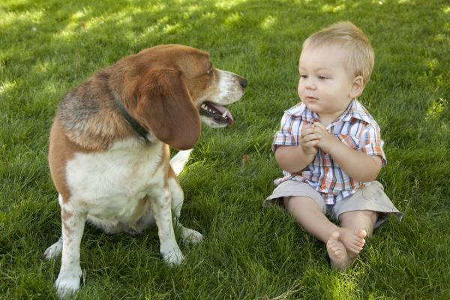
Notes:
As children interact with objects, people, and animals in their environment, they create many associations between these entities and different meaningful sounds.
In a context like this, the child might learn that this animal is called dog.

Slide 3
That's a dog!
Notes:
And as we all know, decades of research have explored how children create mapping between novel words and objects, and on how children develop proficiency in interpreting these mappings during their first years of life.
But in this same context, the child might also learn several other meaningful associations.

Slide 4
woof
That's a dog!
Look at the
bow-wow!
Notes:
For example, the child might learn that this animal is also called "bow-wow," an onomatopoeic word representing the sound that dogs make.
Or the child might learn that dogs bark, creating a link between dogs and their typical vocalization.

Slide 5
animal names
animal vocalizations
onomatopoeic words
woof
That's a dog!
Look at the
bow-wow!
Notes:
Animal names, animal vocalizations, and onomatopoetic words, differ in arbitrariness but they provide consistent meaningful associations between complex and distinct sounds and common objects in children’s environments

Slide 6
Animal names, onomatopoeic words, and vocalizations allow us to investigate:
Children's efficiency in processing linguistic and non-linguistic sounds
The domain-specificity of leaning mechanisms
Notes:
I am particularly interested in these three types of auditory cues because they allow us to compare children's efficiency in processing linguistic and non-linguistic sounds
And they also allow us to investigate the domain-specificity of learning mechanisms

Slide 7
How do children create linguistic and non-linguistic sounds-object associations?
Learning animal vocalizations appears trivial
Word learning is treated as a complex problem of induction (e.g., Markman, 1991)
Notes:
One of the reasons why there's so little research on how children learn and recognize animal vocalizations and environmental sounds in general might be because this kind of learning might seem trivial. Animal vocalizations are causally connected to the animals who produced them; they can be determined by the shape of their vocal track; they are accompanied by synchronous mouth movements; and they can be identified by paying attention to the origin of the sound
In contrast, word learning is seen as a complex problem of induction. In order to figure what a novel word refers to, many researchers argue that children are equipped with constraints on the possible meaning of words.

Slide 8

Where's the dofa?
The bias of mapping a novel word
onto a novel object is known as disambiguation
Notes:
One of the biases that might help children learn the meaning of words is their tendency to map a novel word onto a novel object
There has been recent debate on the importance of these biases for early word learning,
but disambiguation biases have been consistently demonstrated in children two years and older, with less robust effect emerging at earlier ages.

Slide 9
Why do children select a novel object when hearing a novel word?
A lexical phenomenon (de Marchena et al., 2011)
A product of children’s theory of mind (Bloom, 2002; Diesendruck & Markson, 2001)
A general principle of learning (Frank et al, 2011; McMurray et al., 2011)
Notes:
There has been three main theories about the scope of these strategies. That is, why do children select a novel object when hearing a novel word.
Some authors claim that it is a lexical phenomenon that applies only to words
others that it is a product of children’s theory of mind restricted to communicative situations
and more recent approaches explain it is a special case of a general principle of learning that looks for regularities across domains

Slide 10
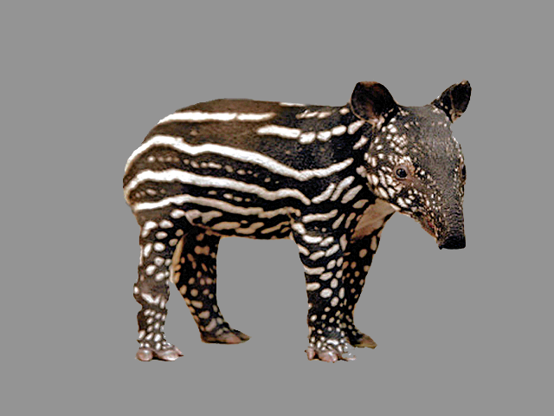
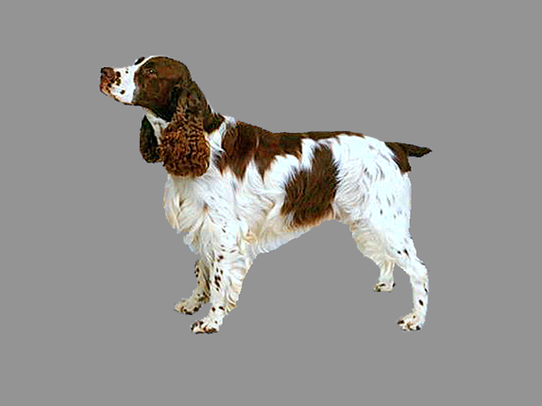
Animal sounds are non-linguistic and non-communicative for humans
"It would be nice to know if [disambiguation biases] apply when children learn the sounds that different animals make"
(Bloom, 2001, pp69)
Notes:
Looking at children's disambiguation biases for animal vocalizations is an interesting way to test these different theories
because these sounds are non-linguistic, and non-communicative for humans.
Therefore, if young children showed disambiguation biases for the vocalizations that animals produce
This could be seen as evidence in favor of domain-general accounts of disambiguation.
"It would be nice to know if [disambiguation biases] apply when children learn the sounds that different animals make"
(Bloom, 2001, pp69)

Slide 11
STUDY 1
How quickly can 30-mo-olds use linguistic and non-linguistic cues to identify a familiar animal?
Do children choose a novel animal in response to a novel animal vocalization?
STUDY 2
If so, do children actually remember the mapping between the novel animal and vocalization?
Notes:
I will be trying to answer three research questions.
Study 1 asks how quickly 30 month olds can use linguistic and nonlinguistic cues to identify a familiar animal, and also whether children would chose a novel animal in response to a novel animal vocalization, as they do for a novel word.
Study 2 focuses on the relation between disambiguation and retention, asking whether children would actually remember the mapping between a novel animal and a novel vocalization created through a disambiguation strategy

Slide 12
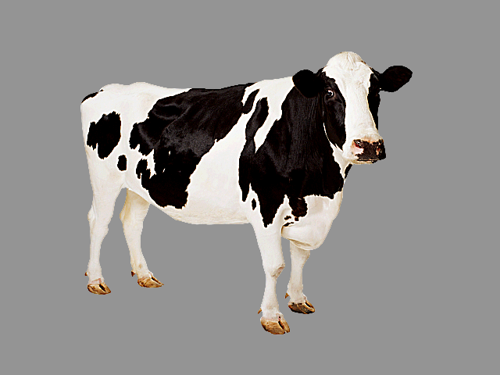
STUDY 1: Children's recognition of the link between a familiar sound and a familiar animal
Where’s the dog?
8 animal-name trials
Which one goes woof-woof?
8 onomatopoeic-word trials
Listen [dog barking]
16 animal-vocalization trials
horse-dog-cow-sheep
pangolin-tapir
30-month-olds (n=21)
Notes:
In study 1, we tested 21 30-month-olds, in two different trial type.
In half the trials, children saw two familiar animals or a familiar and a novel animal, and they heard a familiar sound.
This sound could be a familiar animal name, as done in many studies looking at children's processing of familiar words.
But this sound could also be a familiar onomatopoeic word.
Or a familiar animal vocalization.

Slide 13
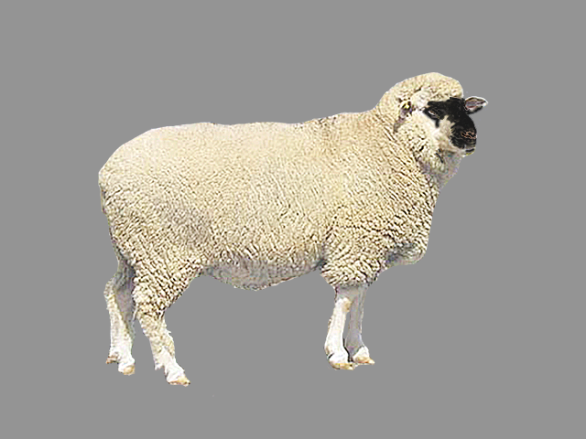
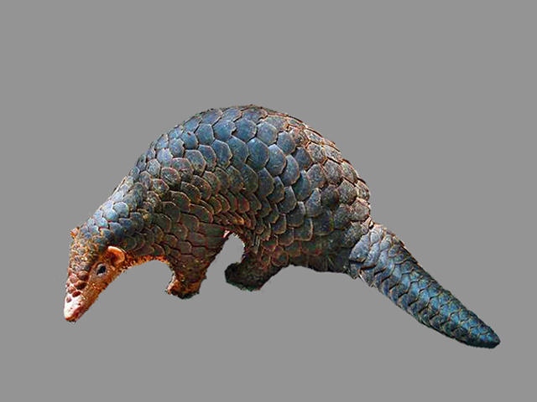
Children see a familiar and novel animal and hears a novel sound
Where’s the nadu?
6 animal-name
Listen [novel vocalization]
rhino grunting-gorilla snorting
8 animal-vocalization trials
tapir-pangolin
horse-dog-cow-sheep
Notes:
In the other half of trials, children saw a familiar and a novel animal and heard a novel sound.
There were two kinds of novel sounds, a novel animal name, and a novel animal vocalization.
(i.e., capa, nadu

Slide 14
Measures of processing efficiency
Accuracy: Proportion looking to the target animal [300 to 4300 ms]
RT: Time to shift to the target animal when looking at the distractor animal
Notes:
In all trials, we looked at children's accuracy and reaction time.

Slide 15
STUDY 1
How quickly can 30-mo-olds use linguistic and non-linguistic cues to identify a familiar animal?
Do children choose a novel animal in response to a novel animal vocalization?
STUDY 2
If so, do children actually remember the mapping between the novel animal and vocalization?
Notes:
Now let's go directly to our first question.

Slide 16
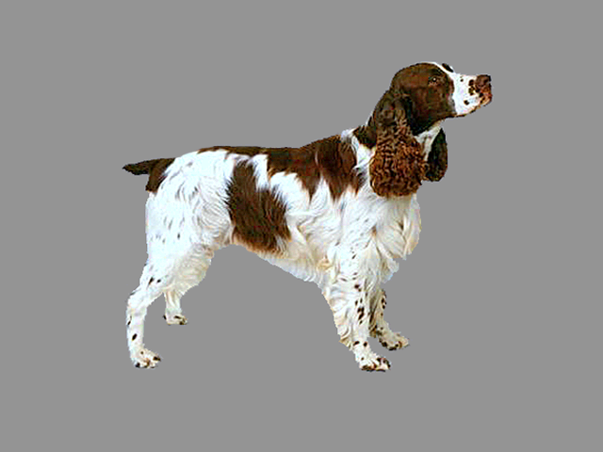
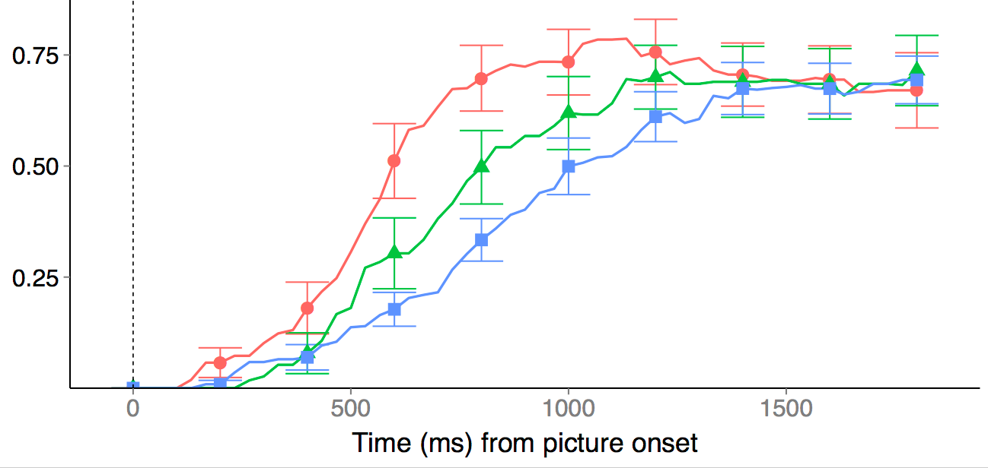
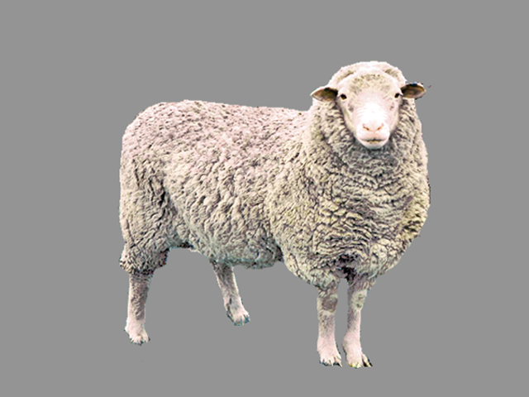
30-mo-olds were fastest to orient to a familiar animal in response to the animal name, and slowest in response to the animal vocalization
D O G
W O O F
% looking
to target animal
[barking]
animal name (650ms - FAST)
onomatopoeic word (828ms)
animal vocalization (906ms - SLOW)
time (ms) from sound onset
Children were reliably above chance on the three conditions
Notes:
These are the results for the trials in which children heard a familiar sound in the presence of two familiar animals or a familiar and a novel animal.
I am showing here children's responses during trials in which they were not looking at the target animal at the onset of the familiar sound.
There are separate lines for children's proportion of looking to the correct animal when they heard an animal name, in red, and onomatopoeic word, in green, and an animal vocalization, in blue
Children were fastest to orient to the target animal in response to the animal name, and slowest in response to the animal vocalization, with onomatopoeic words somewhere in between.

Slide 17
30-mo-olds were fastest to orient to a familiar animal in response to the animal name, and slowest in response to the animal vocalization
D O G
Why?
• Frequency
• Design features
• Representational
W O O F
% looking
to target animal
[barking]
animal name (650ms - FAST)
onomatopoeic word (828ms)
animal vocalization (906ms - SLOW)
time (ms) from sound onset
Children were reliably above chance on the three conditions
Notes:
These differences might be due to massive differences in frequency of exposure between animal names and animal vocalizations
They might be due to differences in signal characteristics between speech and vocalizations. There might be higher information density at signal onset for words than natural animal sounds
Or they might be due to representational differences e.g., words refer, they connect to the lexical system, or they activate more general concepts

Slide 18
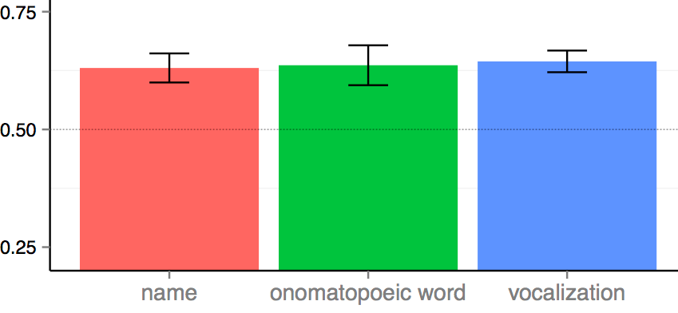
But they all get the job done!
% looking at correct animal
Notes:
But the important take home message is that all the three different sounds get the job done.
Children looked at the correct animal reliably above chance when hearing the animal name, an onomatopoeic word, and an animal vocalization, with accuracy indistinguishable across conditions.

Slide 19
But they all get the job done!
Children had three different sounds mapped to the same familiar animal
% looking at correct animal
Notes:
And I want to bring attention here to the fact that 30-month-olds had already mapped three different sounds to the same familiar animals.

Slide 20
STUDY 1
How quickly can 30-mo-olds use linguistic and non-linguistic cues to identify a familiar animal?
Do children choose a novel animal in response to a novel animal vocalization?
STUDY 2
If so, do children actually remember the mapping between the novel animal and vocalization?
Notes:
Our second question focuses on the domain-generality of disambiguation biases. We asked whether children would map a novel animal vocalization to a novel animal.

Slide 21
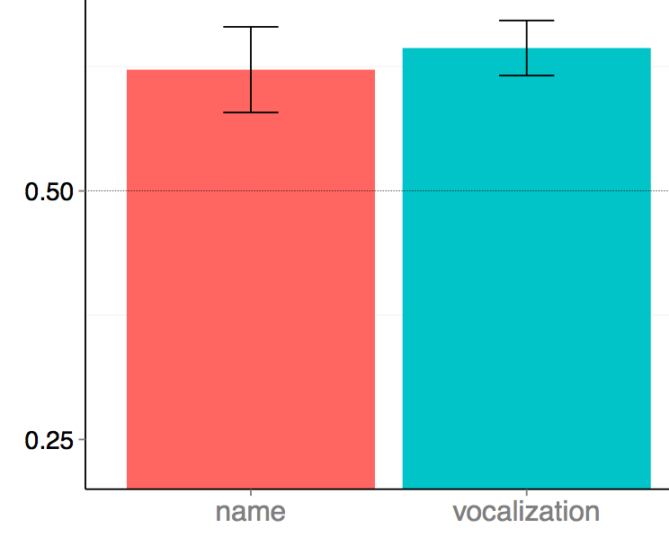

When a novel animal was paired with a familiar animal, children were above chance in choosing the novel animal in response to a novel animal name or vocalization
% looking at novel animal
Novel
name
Novel
vocalization
No differences in accuracy and RT between conditions
Notes:
I am showing here children's proportion looking to the novel animal for the trials in which they heard a novel sound in the presence of a familiar and a novel animal.
As you can see, children reliably looked at the novel animal when hearing the novel name and the novel animal vocalization, with accuracy and RT indistinguishable across conditions.

Slide 22
When a novel animal was paired with a familiar animal, children were above chance in choosing the novel animal in response to a novel animal name or vocalization
• Earliest age of nonlinguistic disambiguation
• Favor domain-generality
% looking at novel animal
Novel
name
Novel
vocalization
No differences in accuracy and RT between conditions
Notes:
This is the earliest age at which one-to-one biases have been observed in a domain other than word learning.
Our results cannot be easily explained by pragmatic or lexical-constraints accounts, and seem to favor a domain-general learning mechanism that seeks simple regularities in complex learning tasks
While highly-familiar words might be a particularly effective cue to identify familiar animals, words and animal vocalizations seem to be equally effective cues to disambiguate novel animals

Slide 23
Fast mapping, slow learning
Referent selection is related to – but should not be conflated – with learning.
Bion, Borovsky, & Fernald (2012) Cognition
Horst & Samuelson (2008) Infancy
McMurray, Horst, & Samuelson (2013) Psych Review
Notes:
In STUDY 1, we showed that children show disambiguation biases for words and for novel animal vocalization.
But it is not clear whether children could use this strategy to learn about novel sounds in their environment.
Some recent studies and computational models emphasized that referent-selection is related – but should not be conflated with learning

Slide 24
STUDY 1
How quickly can 30-mo-olds use linguistic and non-linguistic cues to identify a familiar animal?
Do children choose a novel animal in response to a novel animal vocalization?
STUDY 2
If so, do children actually remember the mapping between the novel animal and vocalization?
Notes:
So study 2, we focus exclusively on novel animal vocalizations, asking whether children actually remember the mapping between a novel animal and vocalization.

Slide 25
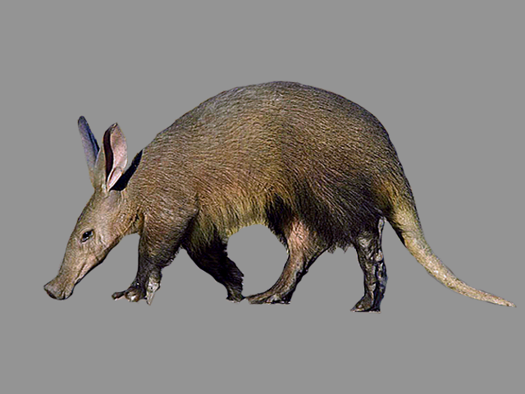
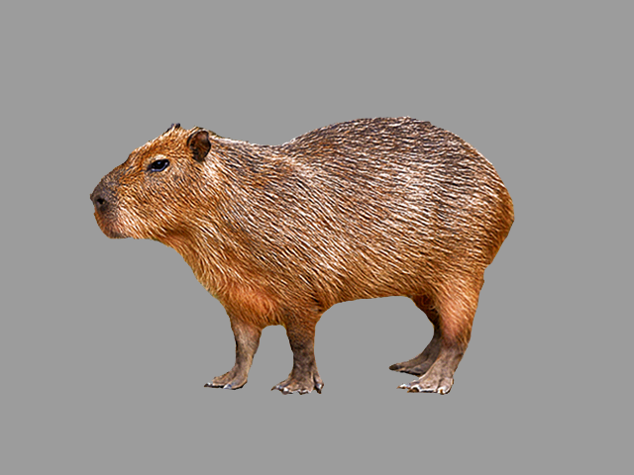
30-month-olds (n = 20) in Familiar, Disambiguation, and Retention trials - same design as Bion, Borovsky, & Fernald (2012)
16 Familiar-vocalization trials
(e.g., barking)
8 Disambiguation trials
8 Retention trials
aardvark - capybara
New animals and focus exclusively on animal vocalizations
Notes:
The design here is the exact same one of a recent study we did with familiar and novel words.
In order to make sure that our results in Study 1 were not due to the nature of our stimuli, we chose two different novel animals, an aardvark and a capybara.
We had three different trial types.
In Familiar-vocalization trials, children saw two familiar animals or a familiar and a novel animal and they heard a familiar animal vocalization.
In disambiguation trials, children saw a familiar and a novel animal and heard a novel animal vocalization.
And in retention trials, children saw two familiar animals from the disambiguation trials and heard one of the novel vocalizations from disambiguation trials.

Slide 26
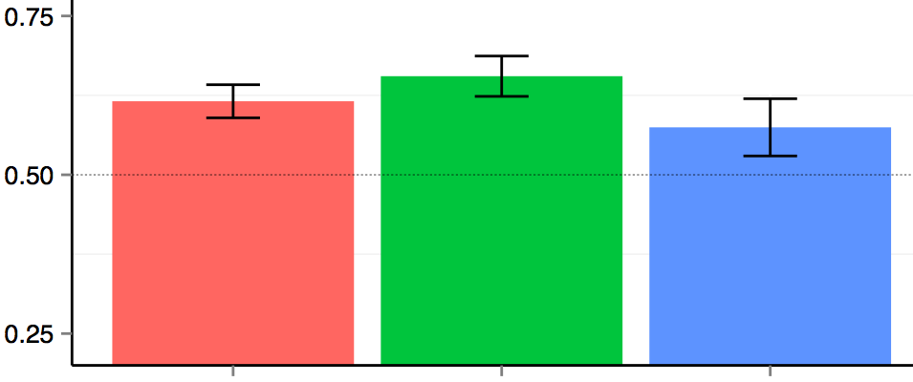
Children reliably chose the novel animal in response to the novel animal vocalization, but showed fragile evidence of remembering this mapping on retention trials
% looking
to target
animal
Familiar
Disambiguation
Retention
Notes:
I am showing here accuracy for these three different conditions. AS in Study 1, children reliably chose a familiar animal in response to a familiar sound, they chose a novel animal in response to a novel animal vocalization, but they showed only fragile evidence of retention.

Slide 27
Children who are better at disambiguating the novel animal vocalizations were better at retention
r (18) = 0.44, p = 0.05
Mean accuracy on
Retention trials
Mean accuracy on Disambiguation trials
Notes:
But as we found in our 2012 paper, there was a relationship between children's disambiguation and retention. Children who were better at determining the referent for a novel word were also better at remembering this link. But as you can see here, basically everyone was above chance on disambiguation, but that does not necessarily resulted in retention.

Slide 28
STUDY 1
How quickly can 30-mo-olds use linguistic and non-linguistic cues to identify a familiar animal?
Do children choose a novel animal in response to a novel animal vocalization?
STUDY 2
If so, do children actually remember the mapping between the novel animal and vocalization?
Notes:
To summarize, I started this presentation trying to answer three different research questions.
The first was about processing.
The second was about disambiguation
And the third was about learning.

Slide 29
30-mo-olds were fastest to orient to a familiar animal in response to the animal name
But they also oriented to a familiar animal when hearing a familiar onomatopoeic word or animal vocalization
Disambiguation biases are not restricted to the linguistic domain and they do not necessarily lead to learning
Notes:
30-mo-olds were fastest to orient to a familiar animal in response to the animal name
But they also oriented to a familiar animal when hearing a familiar onomatopoeic word or animal vocalization
As for disambiguation and learning, these findings add to a recent body of research suggesting that
disambiguation biases are not restricted to the linguistic domain and they do not necessarily lead to learning

